Slide 1
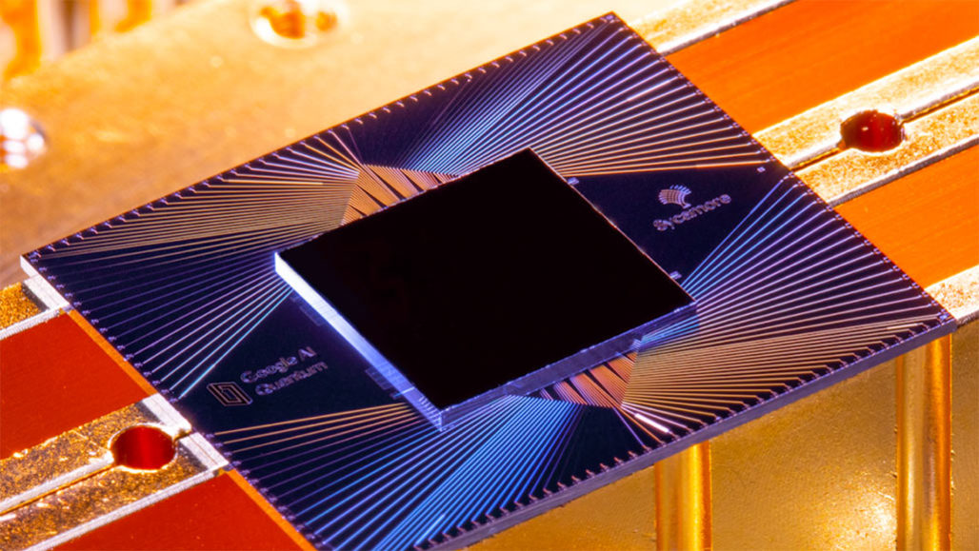
Superconducting Quantum Processor
Antony S Chirayil
MBT17CS023
Guided by: Praveen G L

Slide 2

Contents
Introduction
History
Quantum Computer and Qubit
QC Performance
Technologies for Implementing QC
Superconducting Qubits
1. Superconducting Qubits Archetypes 2. Transmon Qubit
Qubit Control using Quantum logic gates
1. Gates For Single qubit, Two qubits and Three Qubits 2. Cross-Resonance Gate
Superconducting Quantum Circuit Basics
1. Physical Qubit and Frequency 2. Qubit Layout
3. Qubit Connection 4. Qubit Readout
Quantum Processor
1.Anatomy 2.Quantum Processor Architecture
Dilution refrigerator
D-wave 2000Q
Fields of Application
Conclusion
References

Slide 3

Introduction
Solving the world’s most difficult challenges.
There are several models of quantum computing which includes
quantum circuit model
quantum Turing machine
adiabatic quantum computer
The most widely used model is the quantum circuit

Slide 4
History
1982 – Richard Feynman
Proposed the idea of creating machines based on the laws of quantum mechanics instead of the laws of classical physics.
1985 - David Deutsch
Developed the quantum Turing machine, showing that quantum circuits are universal.
1994 - Peter Shor
Produced a quantum algorithm to factor very large numbers in polynomial time.
1997 - Lov Grover
Develops a quantum search algorithm with O(√N) complexity

Slide 5
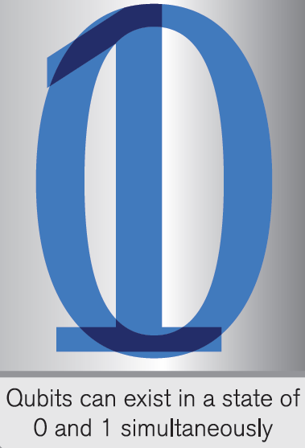
What is a Quantum Computer and Qubit?
Make use of two key principles of quantum physics:
Superposition
Entanglement
Qubit can be either:
0 or 1
0 and 1 at the same time

Slide 6
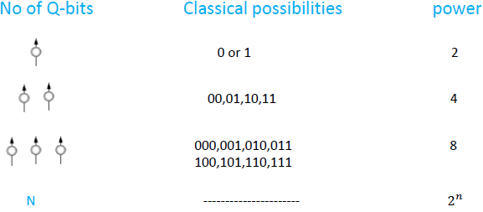
Quantum Computer Performance
Offers vast parallelism
The exponential increase in power
A 100 Q-bit quantum computer is more power full than a supercomputer

Slide 7
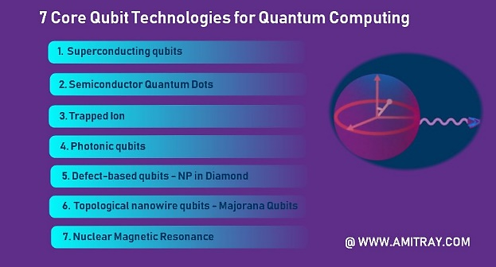

Technologies for implementing Quantum Computing

Slide 8
Superconducting Qubits
Superconducting qubits are solid state electrical circuits. Compared with the qubits based on other quantum systems(such as trapped ions, nuclear magnetic resonance, linear optical systems, etc.), superconducting qubits have the following advantages:
High designability.
Scalability.
Easy to couple.
Easy to control.

Slide 9
Superconducting Qubit Archetypes
Superconducting qubits generally consist of superconducting electrodes, or islands, that are interconnected by Josephson junctions.
According to different degrees of freedom, superconducting qubits are mainly divided into three categories:
charge qubits
flux qubits
phase qubits.
Based on the three superconducting qubit archetypes, many
new types of superconducting qubits are derived, such as
Transmon-type qubit
C-shunt flux qubit
Fluxonium
0-π qubit

Slide 10
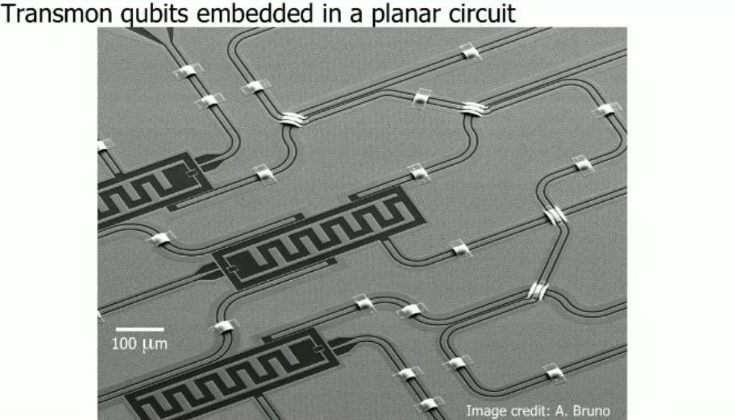
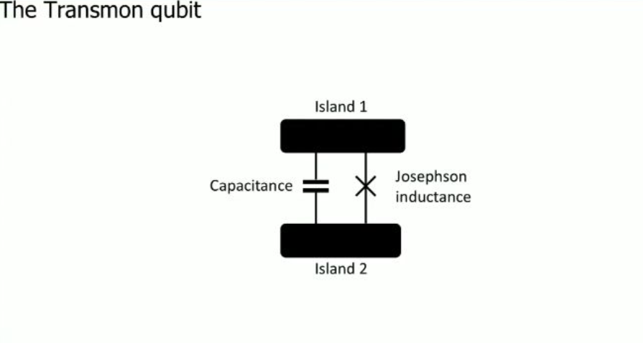
Transmon qubit
The Transmon is the superconducting qubit.
Transmon-type qubit are Transmon, Xmon, Gmon, 3D Transmon etc.,
The most popular superconducting qubit
Consists of two islands interconnected by one junction. The inductance is provided by a Josephson junction.
.

Slide 11
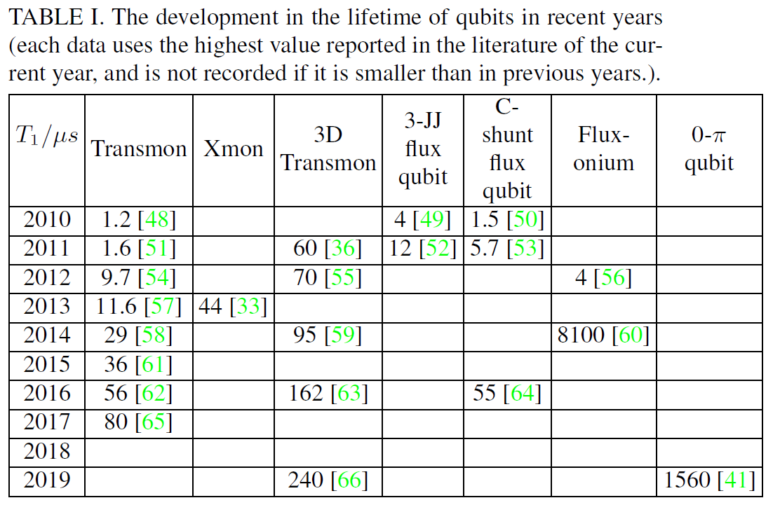
Qubit’s lifetime
By improving the structure and parameters of the superconducting qubits, as well as the preparation techniques and materials, the lifetime of the superconducting qubits has been greatly enhanced.
TABLE I summarizes the development in the lifetime of qubits over the past decade.

Slide 12
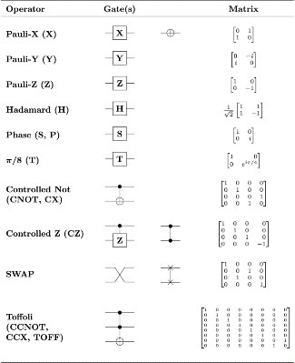
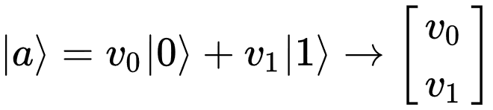
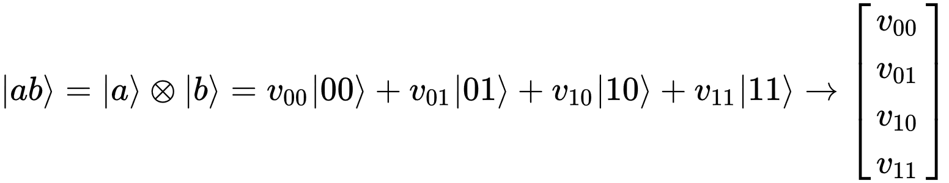
Qubit Control using Quantum Logic Gates
Quantum logic gates are represented by unitary matrices.
Quantum Gates are reversible
Quantum states are typically represented by "kets", from a mathematical notation known as bra-ket.
The vector representation of a single qubit is:
The value zero is represented by the ket | 0 ⟩ = [ 1 0 ] and the value one is represented by the ket | 1 ⟩ = [ 0 1 ]
The vector representation of two qubits is:

Slide 13

Gates For Single qubit, Two qubits and Three Qubits
Single Qubit Control:
In accordance with Bloch sphere:
Hadamard (H) gate
Pauli-X , Y, Z gate
Phase shift gates
Two Qubit Control:
Swap (SWAP) gate
Controlled gates (CNOT)
Frequency tuning gates
Cross-resonance gate
Three Qubit Control:
Toffoli (CCNOT) gate
Fredkin (CSWAP) gate
Multiple Qubit Control:
Multi-qubit gates

Slide 14
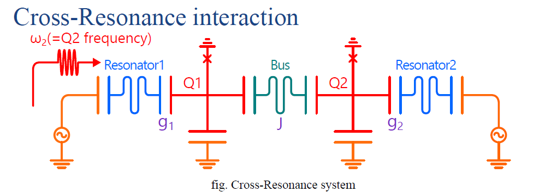
Cross-Resonance Gate
The cross-resonance gate is an entangling gate for fixed frequency superconducting qubits, which is implemented by applying a microwave drive to a system of two coupled qubits
The cross-resonance gate was first implemented in 2011
CNOT gate,so-called two-qubit entangling gate,is used here
Typical pulse duration : 200-500ns
Typical gate fidilities: 96-99%

Slide 15

Quantum Processing Unit : Basics
Qubits:
Two-level systems
Two qubit entangling gates
Qubit Readout
0
1
| 0 ⟩
| 1 ⟩
| 0 ⟩
| 1 ⟩
| 0 ⟩
| 1 ⟩
| 0 ⟩
| 1 ⟩
Single Qubit Control
Single Qubit Control
Single Qubit Control
Single Qubit Control
Conflicting Requirements: Long Coherence, Fast control and Readout

Slide 16
Superconducting Quantum Circuit Basics
Here we focus superconducting quantum processors with Josephson junction-based Transmon qubits and all-microwave cross-resonance two-qubit gates.
Physical Qubit and Frequency
Qubit Layout
Qubit Connection
Qubit Readout

Slide 17
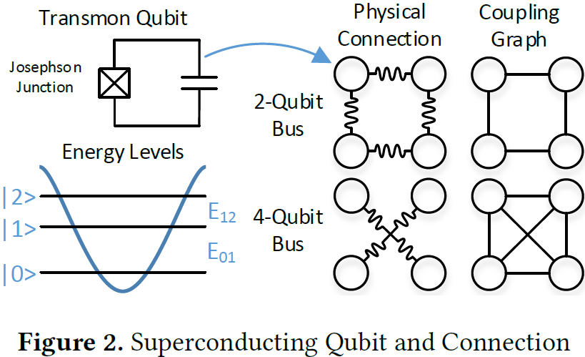
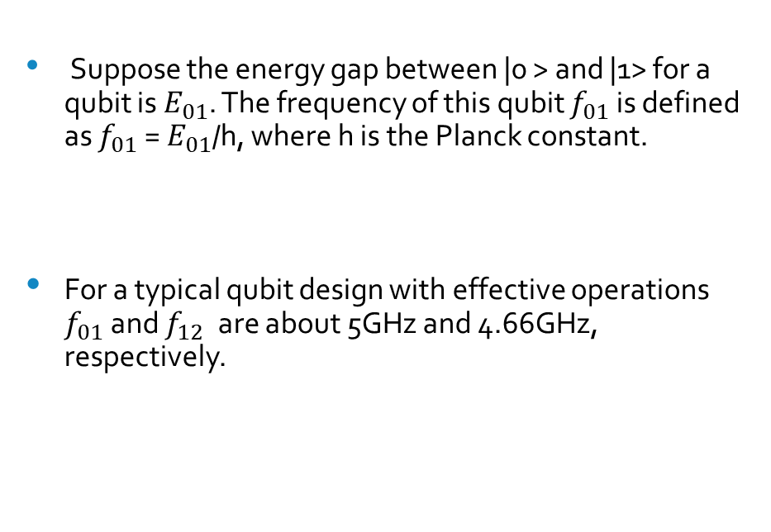
Physical Qubit and Frequency
Suppose the energy gap between |0 > and |1> for a qubit is${ E}_{01}$. The frequency of this qubit $f_{01}$ is defined as $f_{01}$ = $E_{01}$/h, where h is the Planck constant.
For a typical qubit design with effective operations $f_{01}$and $f_{12}$are about 5GHz and 4.66GHz, respectively.

Slide 18
Qubit Layout
The superconducting physical qubits are connected on a 2-dimensional planar substrate. Although the qubit placement can be flexible, major vendors fabricate the qubits in a regularized structure to ensure scalability and reduce the fabrication complexity.
For example:
IBM’s 16-qubit and 20-qubit chips placed their qubits on the nodes of 2x8 and 4x5 lattices, respectively.
Google’s 72-qubit chip placed its qubits on some nodes of an 11x12 lattice

Slide 19
Qubit Connection
To enable two-qubit gates between two physical qubits, resonators, also known as qubit buses, are employed to connect nearby qubits .

Slide 20
Qubit Readout
Fast and high-fidelity qubit readout is crucial in quantum computing.
Techniques of Qubit Readouts are:
High-fidelity single-shot readout.
Dispersive Readout
The dispersive readout is the currently most common readout technique in the circuit QED architecture, which we will briefly introduce in the next section.

Slide 21
Dispersive Readout
Dispersive readout is to obtain the qubit state information through the readout resonator.
The qubit circuit is coupled to the readout resonator through capacitance or inductance, and the state of the qubit is detected by measuring the transmission coefficient of the readout resonator.
During the measurement, the qubit and the readout resonator form the Hamiltonian of the Jaynes-Cummings model

Slide 22
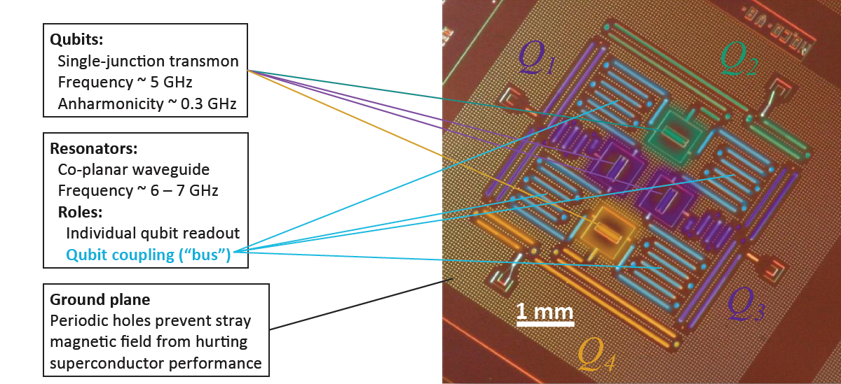
Quantum Processor Anatomy

Slide 23
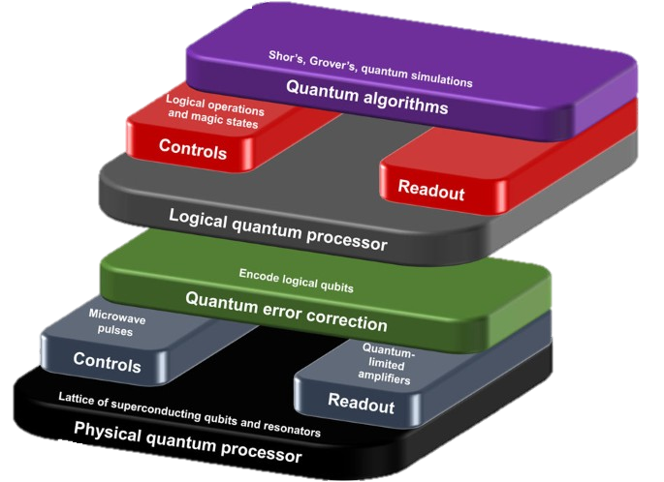
Quantum Processor Architecture
Algorithm
Execution
Logical Layer
Logical Input/Output
Error Correction
I/O FPGAs
Logical Qubits and Logical gate
Physical Qubits
Physical Layer

Slide 24
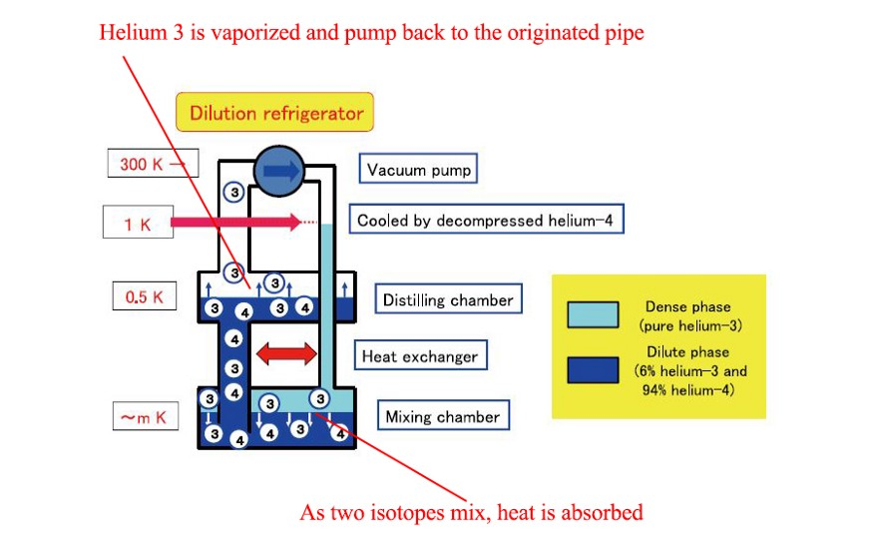
Dilution refrigerator
Maintain an extremely low temperature is important in a superconducting quantum computer
This dilution refrigerator has a system of pipes that contain a mixture of two helium isotopes (isotope ③ and ④)

Slide 25
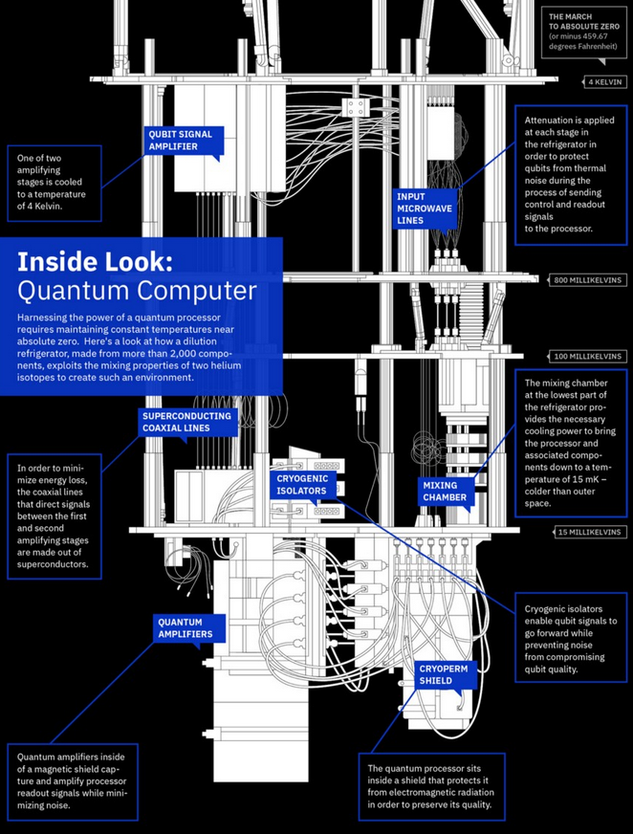
Inside IBM Quantum Computer Dilution Refrigerator
IBM Q’s dilution refrigerator cools temperature from 4° Kelvin to 15 Millikelvins at the Cryoperm shield

Slide 26
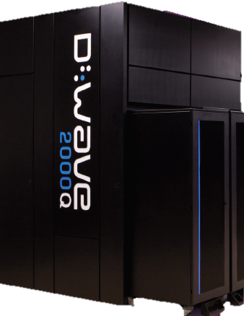
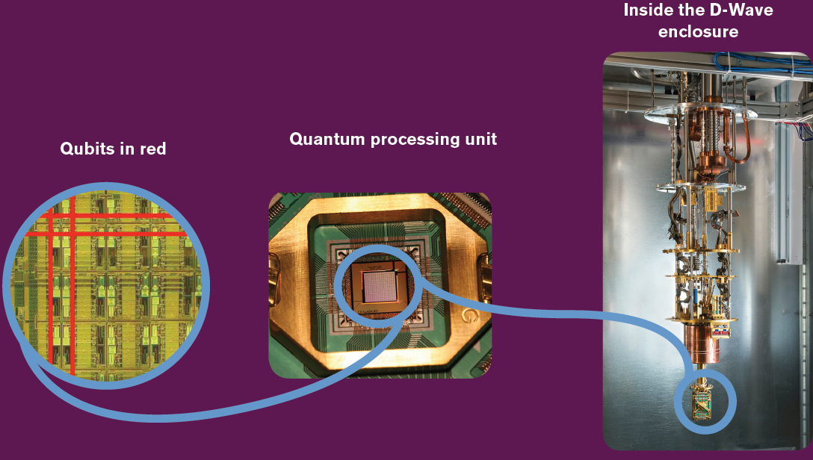
D-wave 2000Q
Built from a lattice of tiny loops of the metal niobium, each of which is one qubit
Operate at less than 15 millikelvin, approximately 180 times colder than interstellar space.
The D-Wave 2000Q QPU by far the most complex superconducting integrated circuit ever built.
QPU dissipates negligible amounts of heat during computation and consumes less than 25 kW.

Slide 27
Fields of Application
Cryptography
Quantum computers have the potential to keep private data safe from snoops and hackers, no matter where it is stored or processed.
Medicine & Materials
A quantum computer mimics the computing style of nature, allowing it to simulate, understand and improve upon natural things—like molecules, and their interactions.
Machine Learning
Research indicates that quantum computing could significantly accelerate machine learning and data analysis tasks.
Searching Big Data
Quantum computing can search the ever-growing amount of data being created, and locate connections within it, significantly faster than classical computers, that will have tremendous impact across many industries.
Financial Modeling
Detecting market instabilities, Developing trading strategies, Optimizing trading trajectories, Optimizing asset pricing and hedging, Optimizing portfolios, etc

Slide 28
Conclusion
In this presentation I have presented basic notions and recent advances in the field of superconducting quantum computing. Recent years have seen an increased interest in superconducting quantum computing.
With the advent of intermediate scale quantum devices, quantum computing will be used as a tool for computing tasks and gradually play an increasingly important role in science and engineering.
Despite the great advances that have been achieved, there is still the need to develop and implement higher quality superconducting qubit, such as improving the qubit connectivity, the gate fidelity, and coherence time, which are the key challenge for the development of superconducting quantum computing.

Slide 29
References
[1] R. Schoelkopf, "Quantum computing with superconducting circuits," 2016 IEEE International Interconnect Technology Conference / Advanced Metallization Conference (IITC/AMC), San Jose, CA, 2016, pp. 43-44, doi: 10.1109/IITC-AMC.2016.7507674.
[2] Huang, H., Wu, D., Fan, D. et al. Superconducting quantum computing: a review. Sci. China Inf. Sci. 63, 180501 (2020). https://doi.org/10.1007/s11432-020-2881-9
[3] “Towards Efficient Superconducting Quantum Processor Architecture Design”, ASPLOS '20: Proceedings of the Twenty-Fifth International Conference on Architectural Support for Programming Languages and Operating Systems March 2020, pp 1031–1045 doi: 10.1145/3373376.3378500
[4] QC—How to build a Quantum Computer with Superconducting Circuit https://medium.com/@jonathan_hui/qc- how-to-build-a-quantum-computer-with-superconducting- circuit- 4c30b1b296cd
[5] Quantum Computing with the IBM Quantum Experience with the Quantum Information Software Toolkit (QISKit),Nick Bronn,Research Staff Member,IBM T.J. Watson Research Center,ACM Poughkeepsie Monthly Meeting, January 2018

Slide 30
Thank you

